Slide 1
WE DONOT INHERIT THE EARTH FROM OUR PARENTS - WE BORROW IT FROM OUR CHILDREN
Gift a Plant and make a difference with your Green Foot Print

Slide 2
Indoor plants improve air quality by:
– Helping to maintain humidity levels: Dry indoor air is blamed for a host of respiratory problems, particularly in the winter, and plants emit water vapor during transpiration. – Producing negative ions: Plant leaves produce negative ions, similar to many air purifying machines. Negative ions attach themselves to (and effectively remove) particles such as dust, mold spores, bacteria, and allergens. The presence of negative ions is credited for increasing psychological health, productivity, and overall well-being.

Slide 3
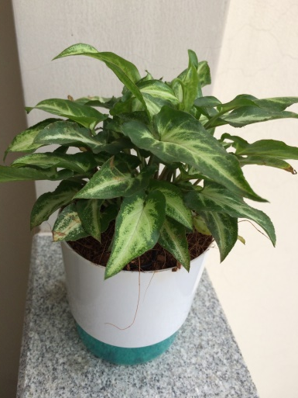
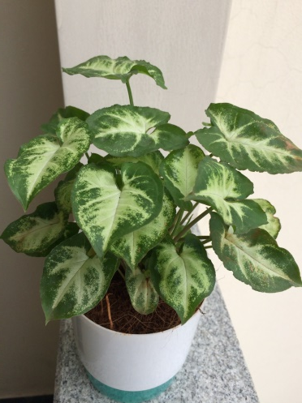
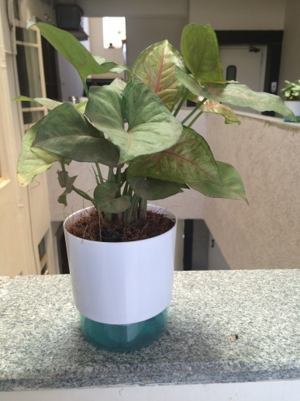
Syngonium variations :
- Studies suggest antibacterial, antioxidant, anti-inflammatory, cytotoxic properties. - Air-purifying plant. Formaldehyde - 67 % Price : 250 & 350 rupees ( small and large self watering pots )

Slide 4
Money Plant variations :
Light: Low light to bright light. No direct sun. Although pothos will tolerate low light, it will have more leaves and better variegation if kept in bright light.
Water: Allow soil to dry slightly between waterings. It will not tolerate soggy soil. Yellow leaves are a sign of overwatering.
Humidity: Average room humidity.
Temperature: Average to warm 60-80°F/16-27°C
- Air-purifying plant. Formaldehyde - 67 % Price : 250 & 350 rupees ( small and large self watering pots )

Slide 5
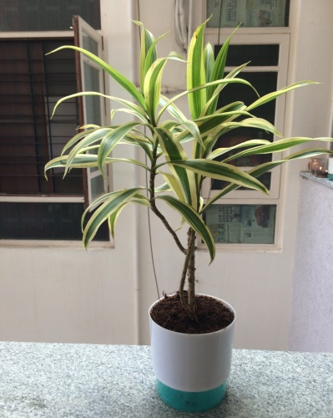
Song of India :
Light: Low light to bright light. No direct sun. Although it will tolerate low light, it will have more leaves and better variegation if kept in bright light.
Water: Allow soil to dry slightly between waterings. It will not tolerate soggy soil. Yellow leaves are a sign of overwatering.
Humidity: Average room humidity.
Temperature: Average to warm 60-80°F/16-27°C
- Air-purifying plant. Formaldehyde - 50 %, Benzene – 78% , Trichlorethylene – 24%
Price : 250 & 350 rupees ( small and large self watering pots )

Slide 6
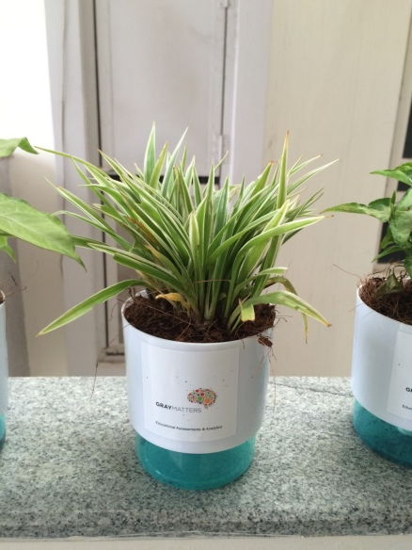
Chlorophytum – Spider Plant :
Light: Bright light. Keep plant out of direct sunlight because it can scorch leaves.
Water: Keep soil evenly moist. If your tap water contains fluoride, use distilled or rainwater.
Humidity: Moderate indoor humidity. If the leaves turn brown and crispy, raise the humidity around it.
Temperature: Average room temps 65-75°F/18-24°C suit this tropical plant perfectly. It doesn't like the cold; don't expose it to anything below 50°F/10°C.
- Air-purifying plant. Formaldehyde - 86% Price : 250 & 350 rupees ( small and large self watering pots )

Slide 7
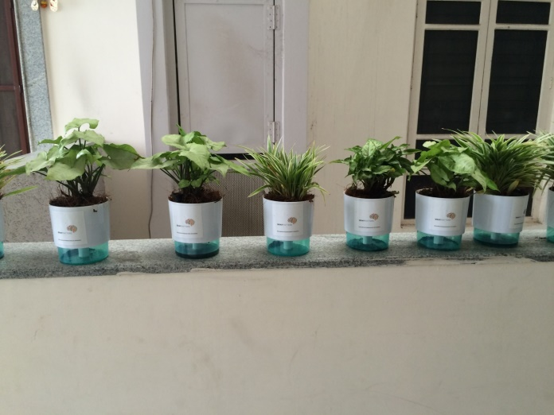
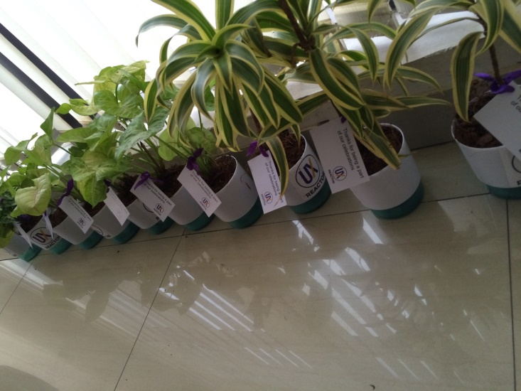
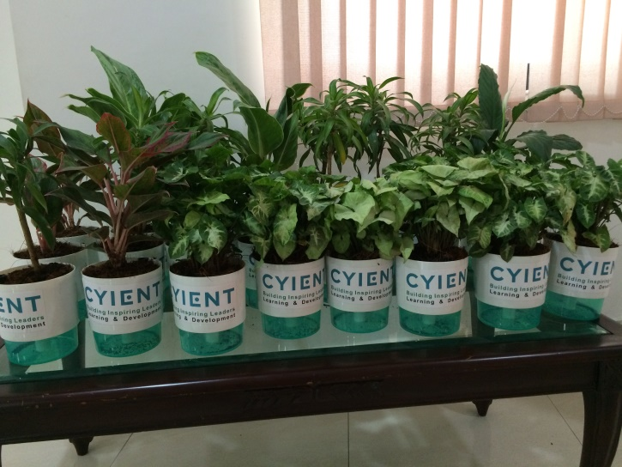
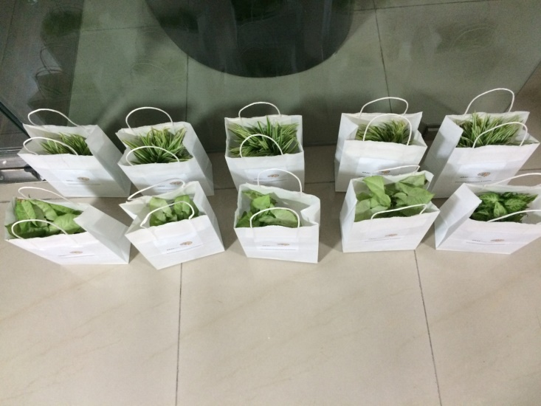
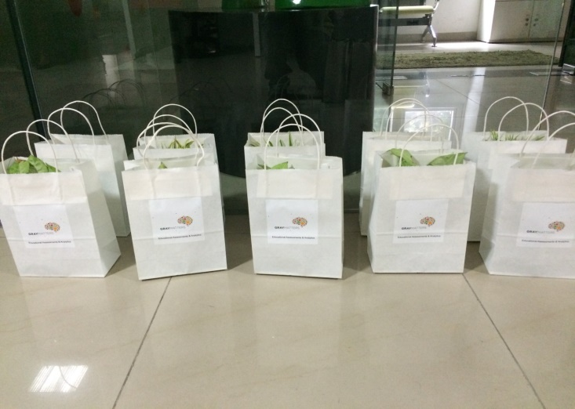
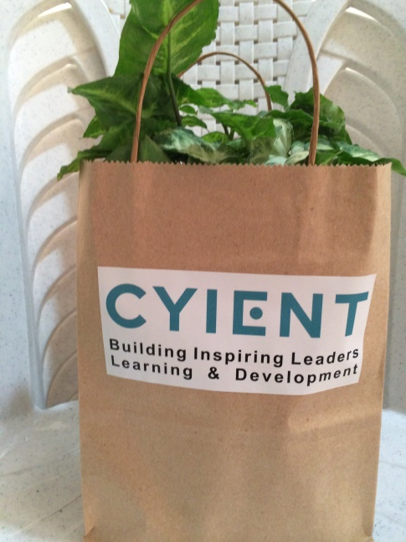
Samples :

Slide 8
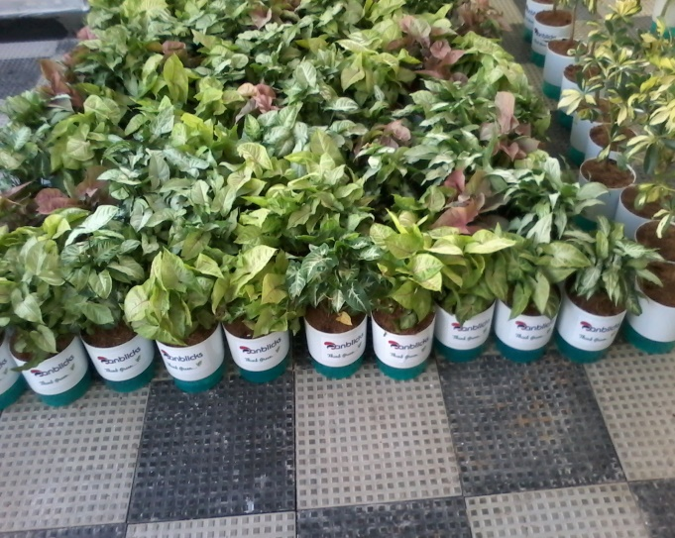
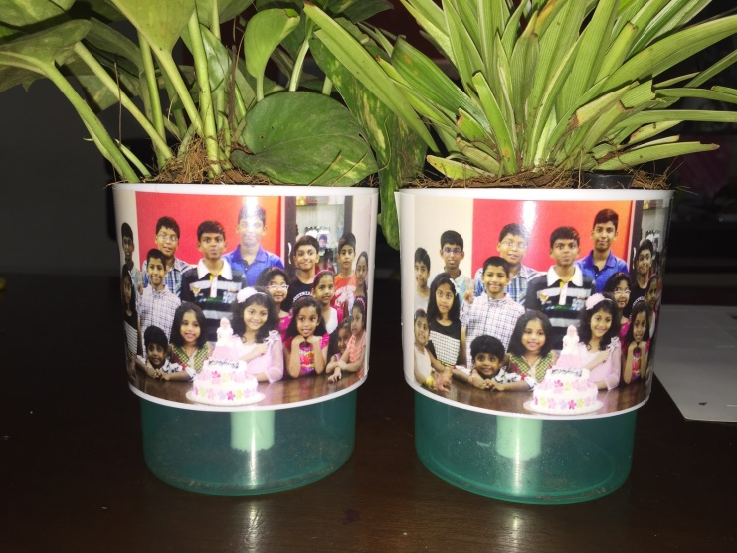
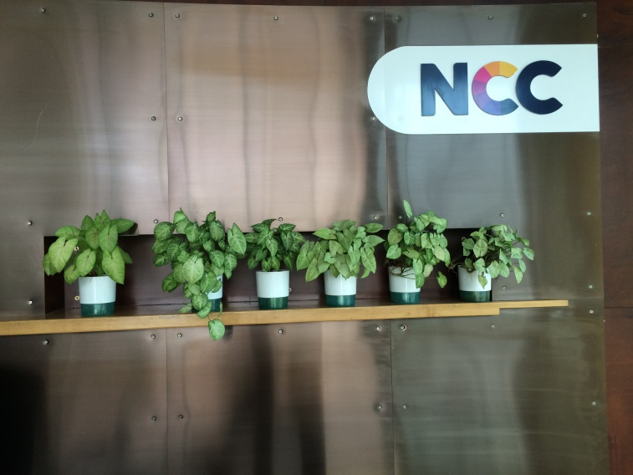
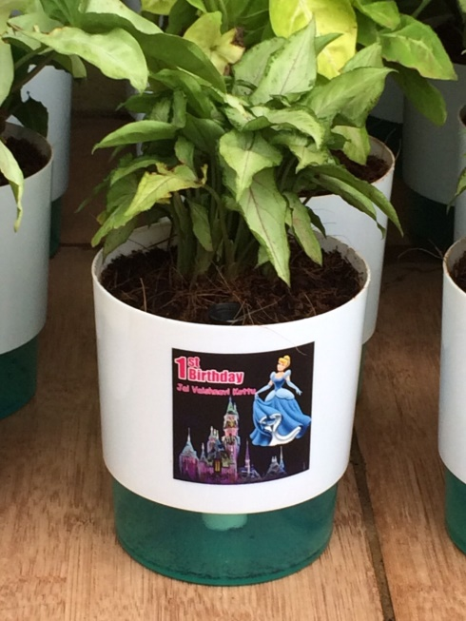
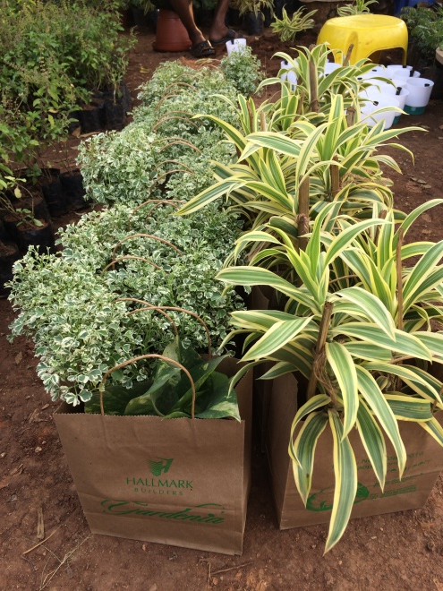
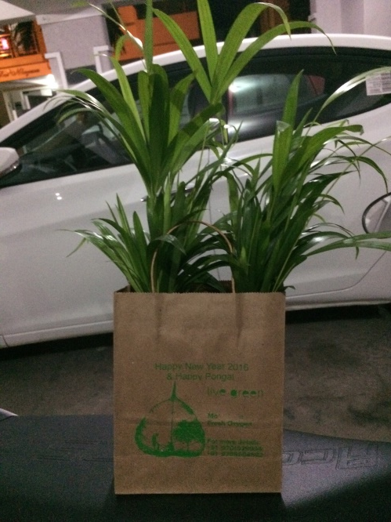
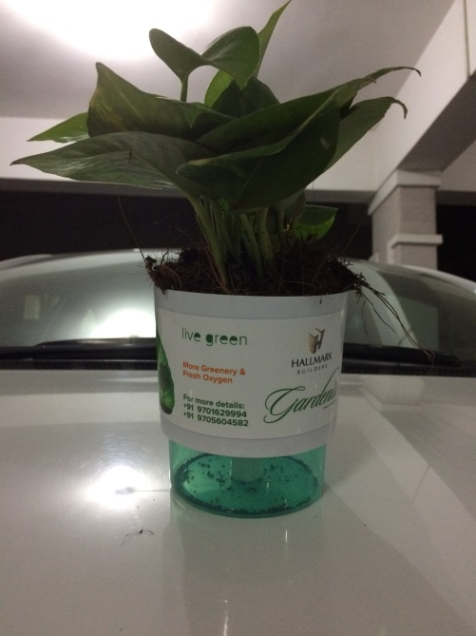
Samples:

Slide 9
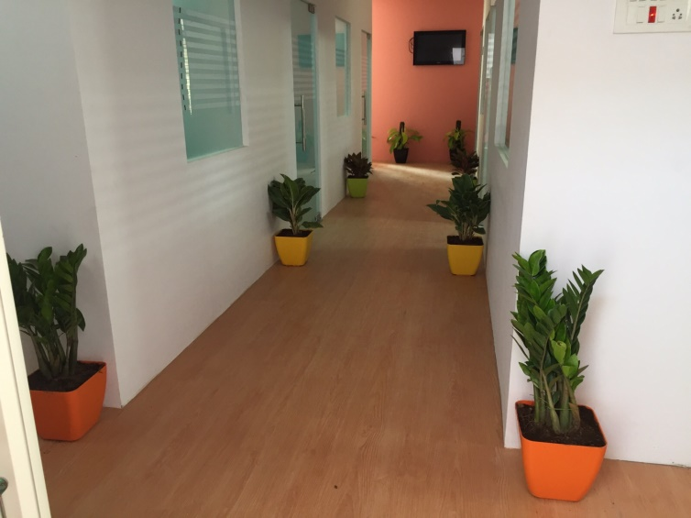
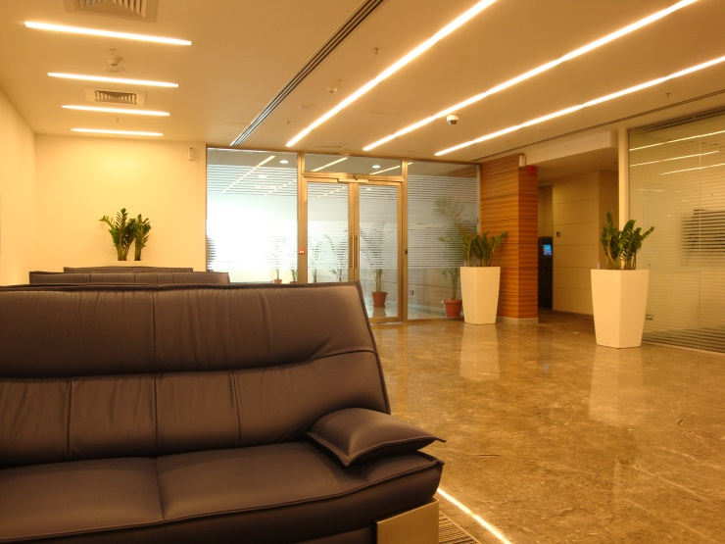
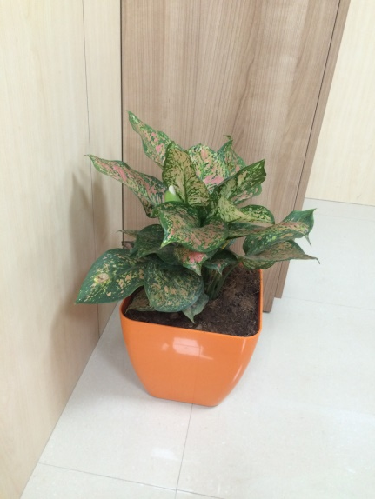
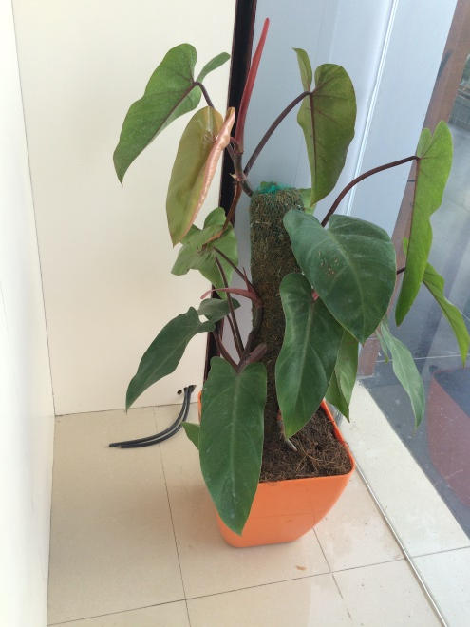
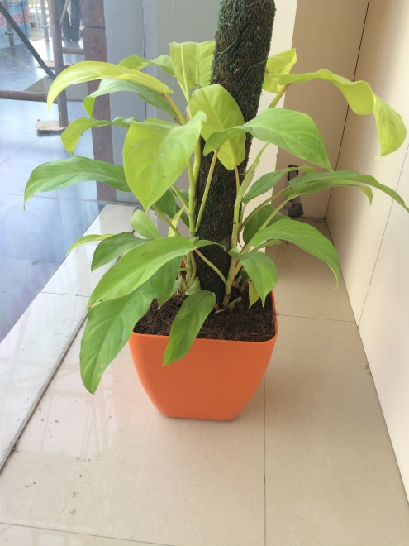
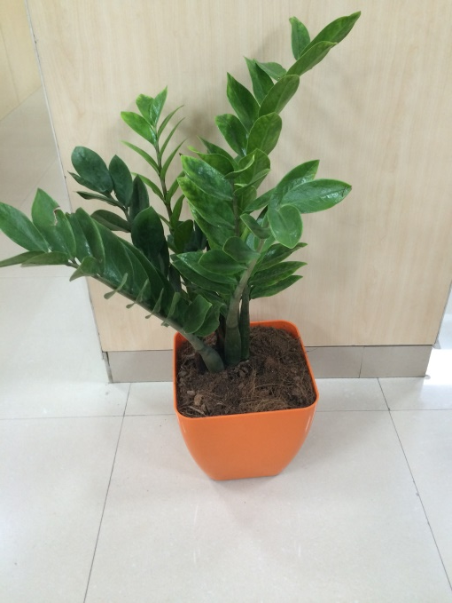
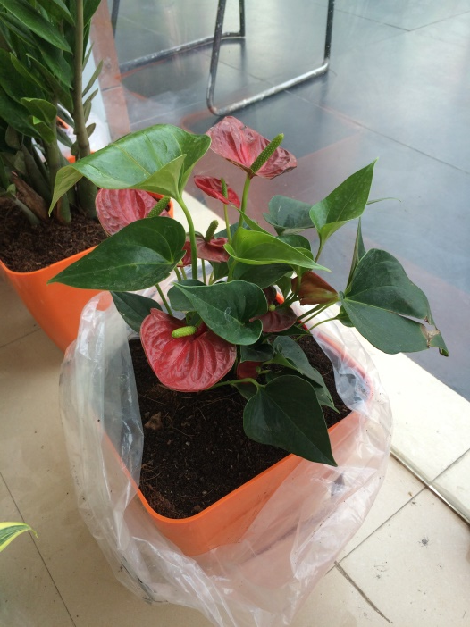
Samples:

Slide 10
Gift A Plant
Thank You

